Slide 1

BDM Capstone Project
Carbon Footprint - Environmental Impact & Business Study of EV Logistics of ZEVO India: A Complete Analytical Study
Jayanthi Shanmukha Teja
Roll: 22F2001007
Project Final Presentation

Slide 2
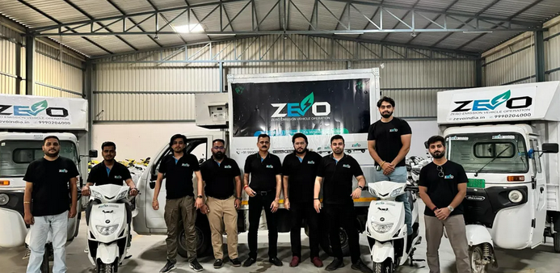
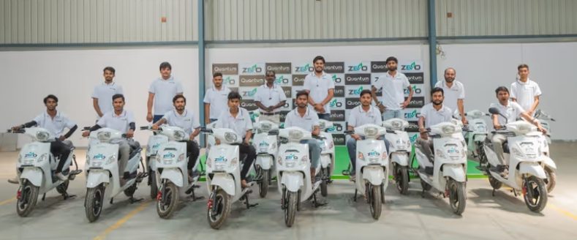
Organization Background
ZEVO India is a B2B EV Logistics platform providing vehicles to many clients across India for their logistics services. They are active in 25+ cities and have a very versatile fleet of Electric Vehicles starting from 2W to big 8 Tonne Trucks.
Documented Fleet is nearly 1200 vehicles but the rest is in the process of getting tracked.
Asset Light model allowed them to scale quickly among multiple clients starting from Flipkart, their major client, Amazon, Big Basket, among others.

Slide 3
Problem Statement
• Measure EV carbon footprint vs ICE baseline
• Analyze operations: utilization, geography, client allocation
• Identify billing leakages, idle vehicles, and inefficiencies
• Recommend actionable improvements based on data

Slide 4
Data & Methodology
• Primary dataset: 1,195 operational vehicle records
• Cleaning: deduplication, date normalization, outlier removal
• Tools used: Excel + Google Collab (Pandas, Matplotlib)
• Analysis: descriptive stats, charts, allocation modeling

Slide 5
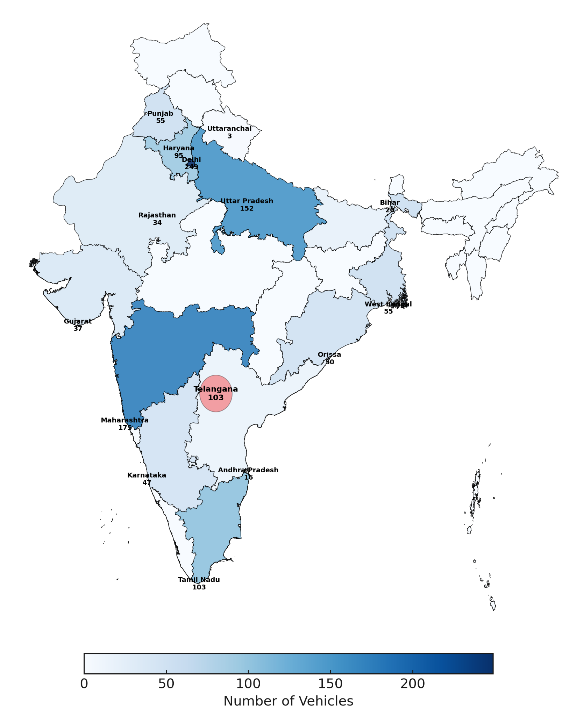
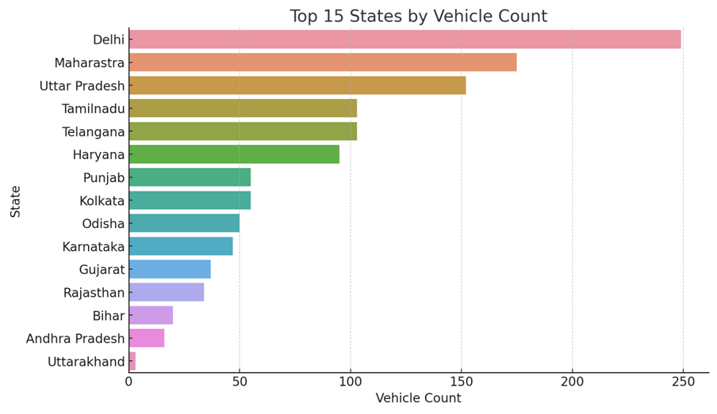

Slide 6
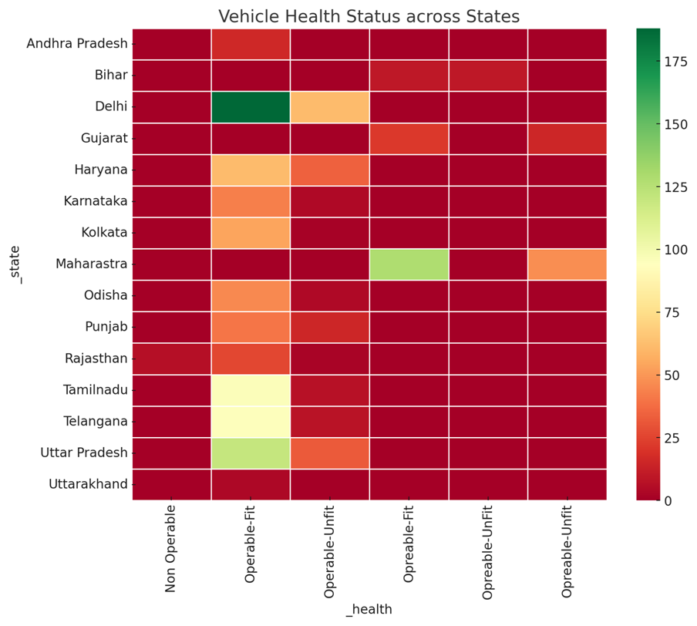
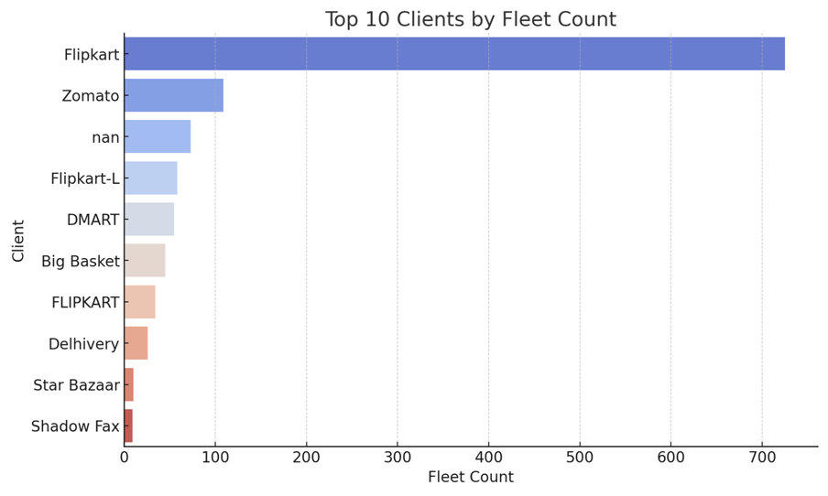

Slide 7
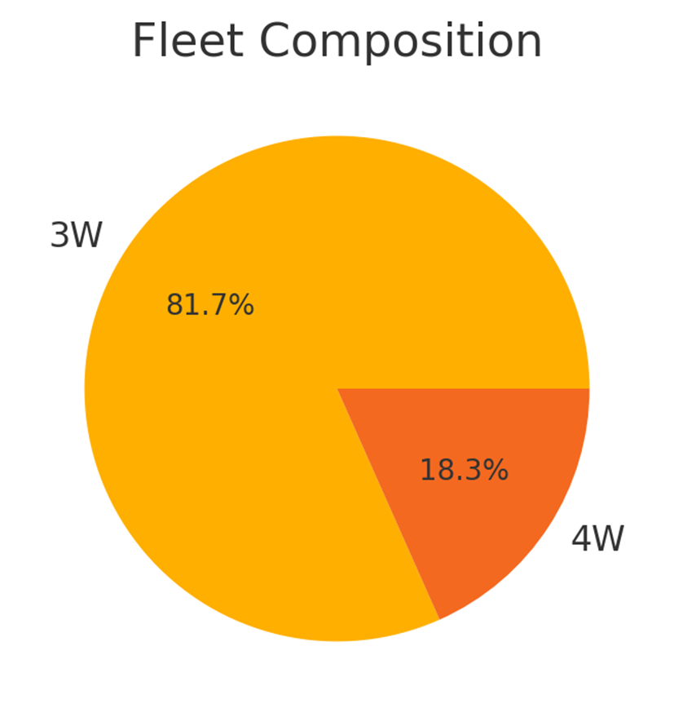
Important Pointers
3W dominate fleet → optimized for last‑mile deliveries
4W can be expanded for heavy‑load or mid‑range routes

Slide 8
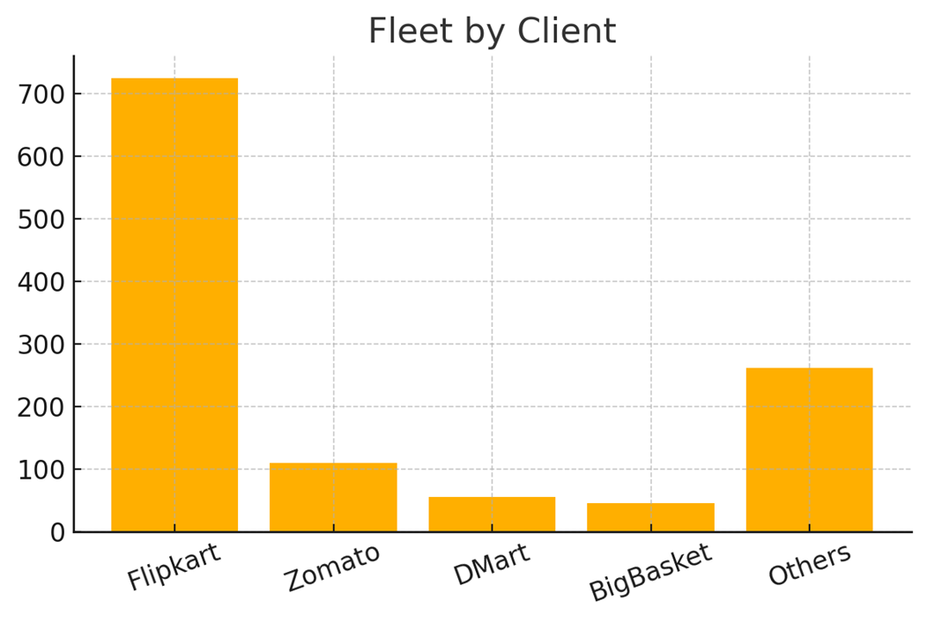
Important Pointers
• Flipkart holds ~60% of fleet → high dependency risk
• Diversify across other marketplaces &
B2B retailers.

Slide 9
Recommendations
• Deploy utilization dashboard for idle‑vehicle redeployment
• Automate billing mismatch detection
• Predictive maintenance to reduce downtime
• Client Performance Efficiency Index for performance scoring
• ESG & carbon reporting dashboard for transparency

Slide 10
Thank You !!

